Slide 1

Health Insurance Cross Sell
Caffeine Crashers

Slide 2
Our Team
Tri Pramudya
Junius Fabianto
Ikko Ananda
Yohanes B
Keizia Purba
Mira Ganis

Slide 3
Data Methodology
PHASE 1
PHASE 2
PHASE 3
PHASE 4
PHASE 5
Business Domain
Data Processing
Exploratory Data Analysis (EDA)
Model Selection & Model Evaluation
Business Solution & Recommendation
Flow

Slide 4


PROBLEM STATEMENT
In 2019 alone, India have over 151 thousand reports due to road accidents.
Each year, about 3-5% of India’s GDP was invested in road accidents.
Nearly 57% of the total vehicles on the road were uninsured as of March 2019, up from 54% in March 2018.
How to predict customers who own health insurance will be interested in vehicle insurance.

Slide 5
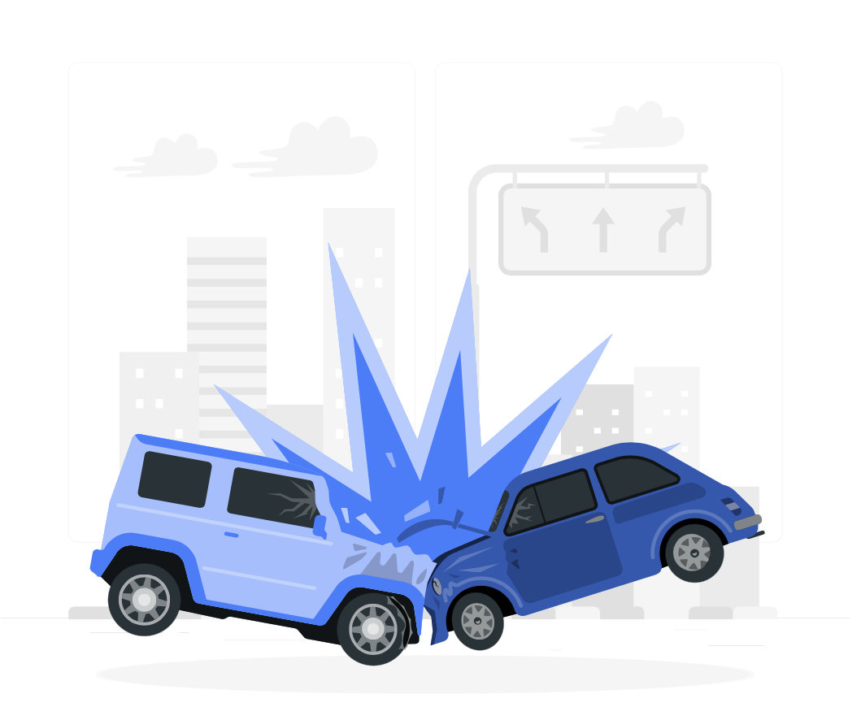
Key Level Highlight
Objectives
Business Metrics
Goals
Build a system that can help company to predict potential customer who interested on having vehicle insurance and identify best feature to improve positive responses from customers toward vehicle insurance.
Response rate
Revenue
To predict customers who own health insurance will be interested in subscribing to vehicle insurance.
Notes:
Changed business metrics to respon rate & revenue

Slide 6
Overview Our Dataset
Variable | Gender | Age | Driving License | Region Code | Previously Insured | Vehicle Age | Vehicle Damage | Annual Premium | Policy Sales Channel | Vintage
Type | Categorical | Numerical | Categorical | Categorical | Categorical | Categorical | Categorical | Numerical | Categorical | Numerical
Values | Male Female | 20 … 85 | Yes No | 0 to 52 | Yes No | < 1 year 1-2 years > 2 years | Yes No | 2,630 … 540,165 | 1 … 163 | 10 … 299
Description | Gender | Age | Does customer have a driver’s license? | Customer region | Does customer have vehicle insurance? | Age of customer’s vehicle | Does customer’s vehicle have damage? | Health insurance annual premium | Sales channel customer belongs to | How long customer has been associated with company?
Response
Categorical
Yes No
Is customer interested in vehicle insurance?

Slide 7
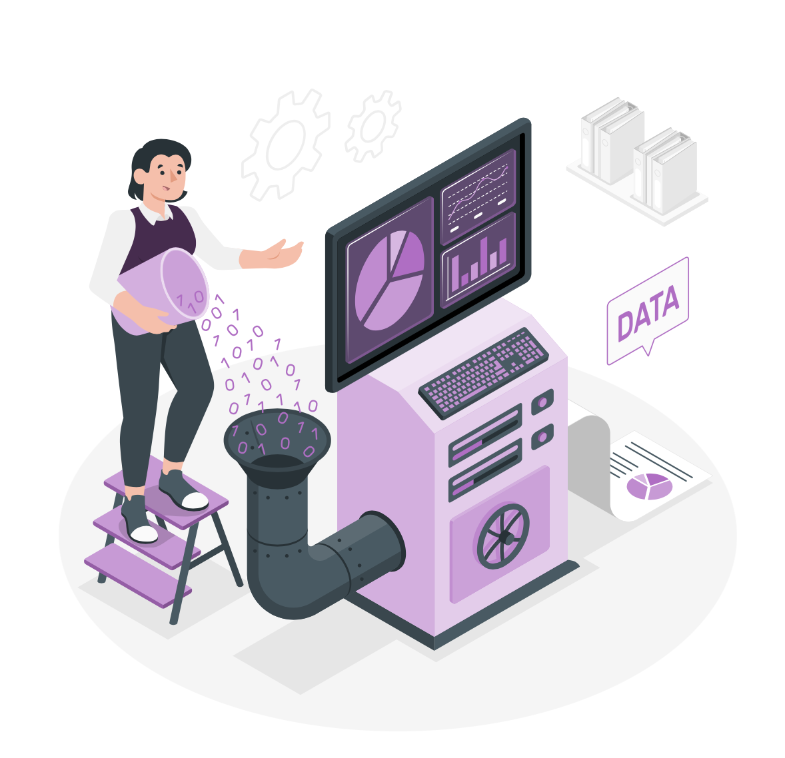
PRE-PROCESSING
Data Collection
Data Cleansing
Feature Engineering
Feature Encoding
01

Slide 8
02
Exploratory Data Analysis (EDA)

Slide 9
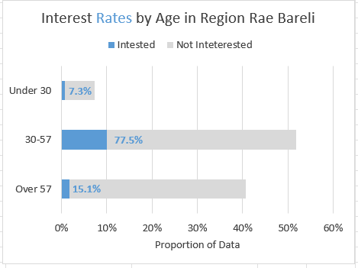
Exploratory Data Analysis
CUSTOMER SEGMENTATION
02

Slide 10
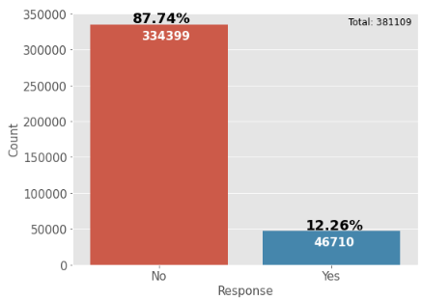
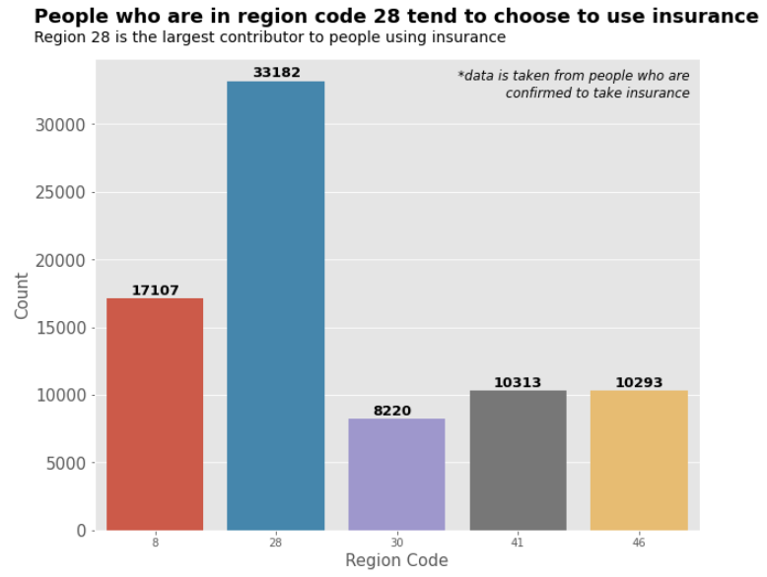
Exploratory Data Analysis
CUSTOMER SEGMENTATION
02
Customers who responds = 46.710 (12.26%)
Customers who aren’t responds = 334.339 (87.74%)
Rae Bareli (Region 28) is the largest contributor to people using insurance.

Slide 11
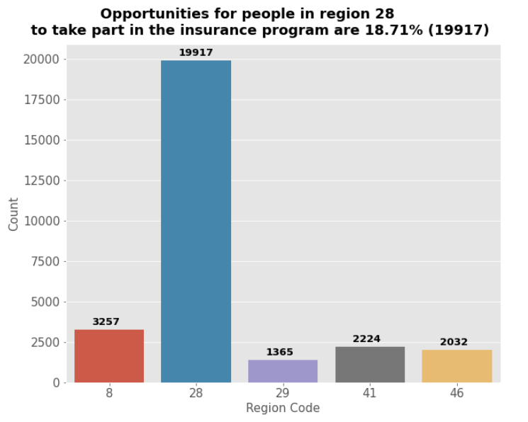
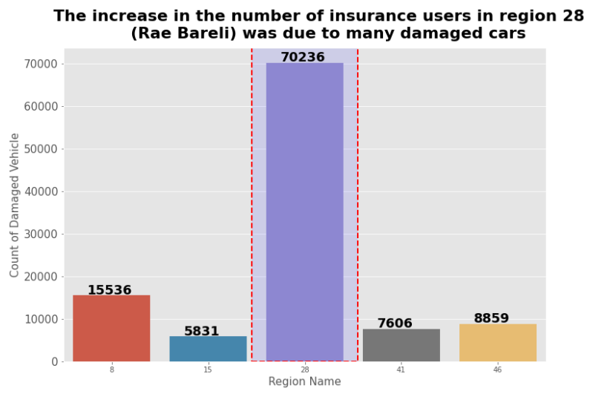
Exploratory Data Analysis
CUSTOMER SEGMENTATION
02

Slide 12

Insight
Interpretation and Insight From EDA
02
The proportion of customer not responding at 87.7%. It shows that, customers are not interested about the idea of having vehicle insurance.
Majority age customers who interested in subscribing vehicle insurance at Rae Bareli (region 28) are between 30 - 57 years old.
Rae Bareli (region 28) is the largest contributor to people using insurance and also have largest positive respond than other regions, but Rae Bareli have largest road accident than other regions.

Slide 13

Model Selection & Model Evaluation
03

Slide 14
Model Selection & Model Evaluation
Model Selection
03
Algorithm | Accuracy | Precision | Recall | F1-Score | AUC | Train Score | Test Score
Naive Bayes | 0.79 | 0.74 | 0.88 | 0.80 | 0.83 | 0.788328 | 0.785942
Random Forest | 0.77 | 0.72 | 0.91 | 0.80 | 0.82 | 0.778859 | 0.774277
Logistic Regression | 0.79 | 0.72 | 0.95 | 0.82 | 0.85 | 0.793805 | 0.79387
KNN | 0.76 | 0.73 | 0.84 | 0.78 | 0.89 | 0.832044 | 0.763664
Decision Tree | 0.76 | 0.68 | 1.00 | 0.81 | 0.76 | 0.75908 | 0.763537
XGBoost | 0.80 | 0.73 | 0.93 | 0.82 | 0.85 | 0.797983 | 0.795819
Extra Trees | 0.76 | 0.73 | 0.84 | 0.78 | 0.99 | 0.998796 | 0.760492

Slide 15
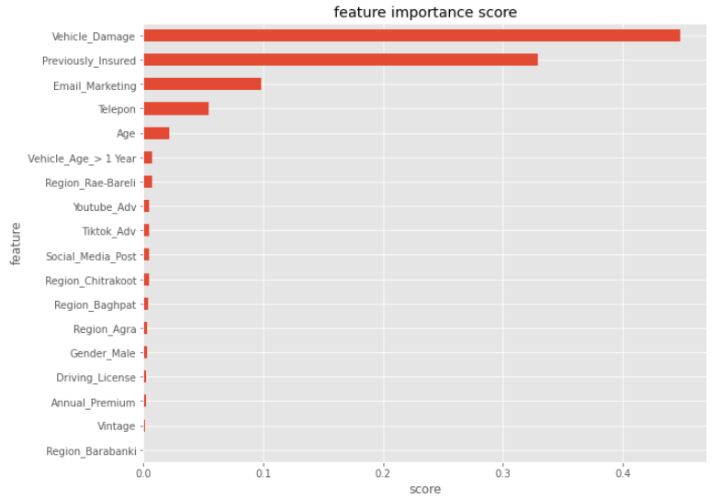
Model Selection & Model Evaluation
Model Evaluation: Show Importance Features
03

Slide 16

Model Selection & Model Evaluation
Conclusion Model
03
We will choose in this case is XGBoost Machine Learning. This model is able to predict the label of the target customer who is response and not response at an recall model with value 93% and AUC score at 85%.
This means our model can improve our response rate for predicting customers who interested in subscribing vehicle insurance.

Slide 17

Business Solution & Recommendation
04

Slide 18
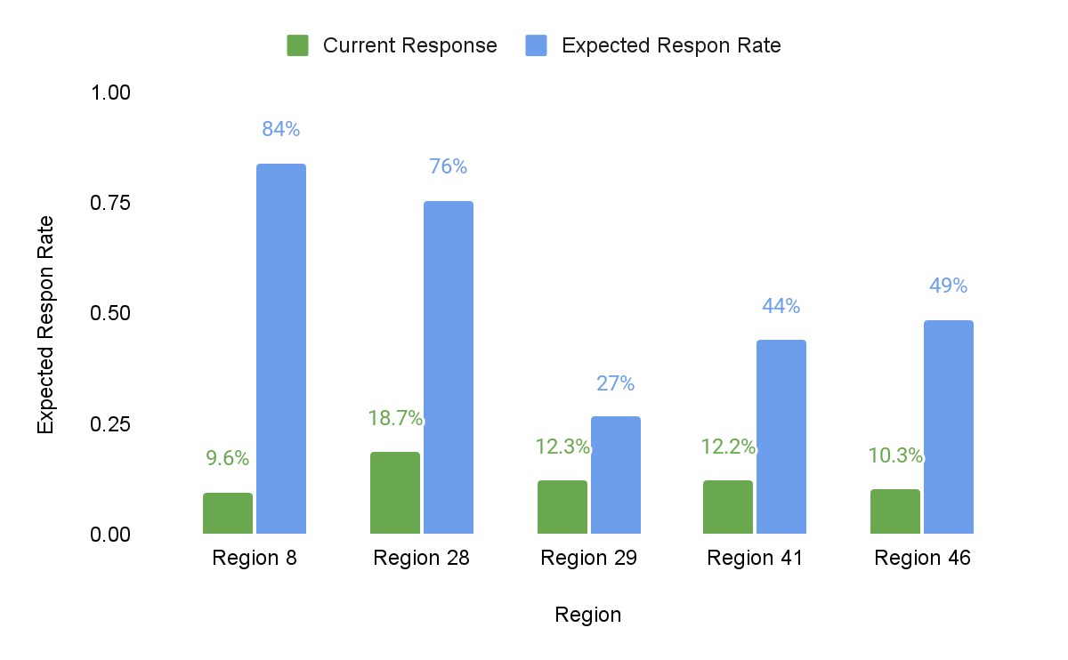
Business Recommendation
Response Rate
Key Highlight : These are the data we got after we use 93% recall.
From this model, we can predict our responses rate for several region by 56% in average.
Region 28 have significant improvement by 76%, because we reached potential customer that have damaged vehicle by 70.236 cases.

Slide 19
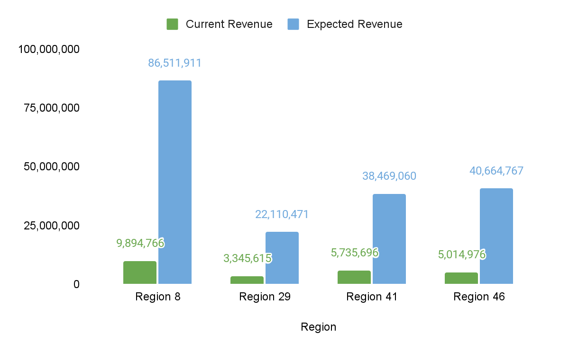
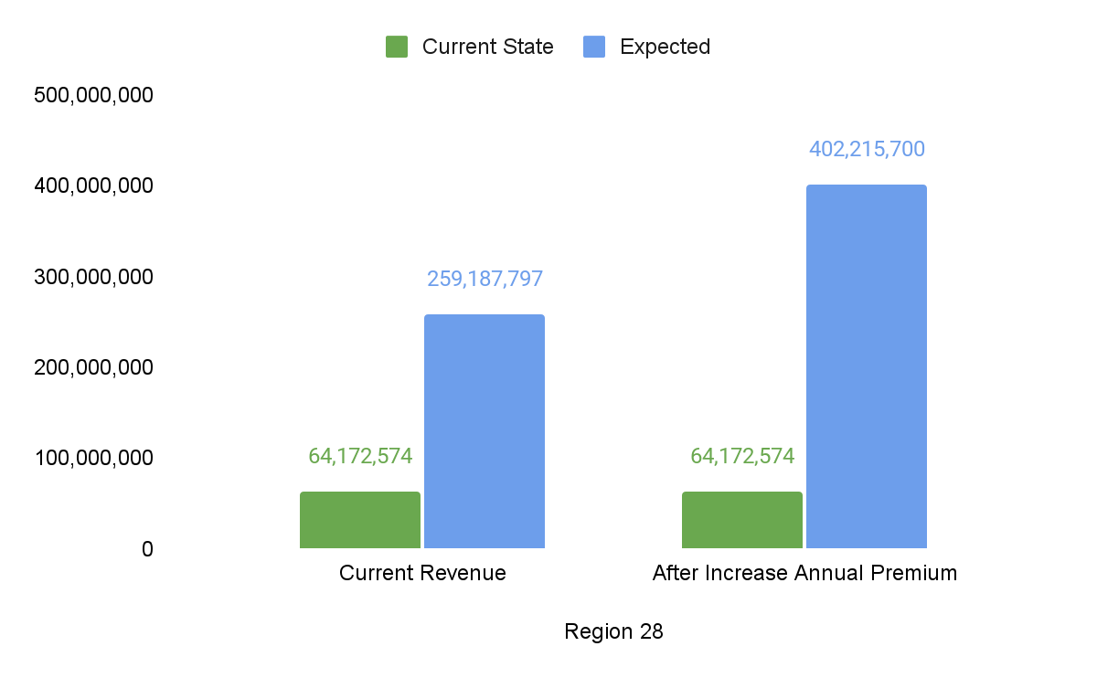
Business Recommendation
Revenue
Key Highlight : These are the data we got after we use 93% recall.
From this model we can predict for region 28 from current revenue by 64.172.574 to 259.187.797 with normally premium.
By Increase annual premium, we can predict for region 28 with Expected revenue by 402.215.700
Overall in others region’s we can expected to improve revenue.
Notes:
Region 28 annual premium dinaikin karena VD tinggi
Region lain response 1 dinaikkin

Slide 20


Business Solution & Recommendation
Business Recommendation
04
Keep Reaching Customers via Telemarketing and Email.
Advertise our insurance program
(Cost 153,000 Rupee for youtube ads)
( Wifi : Cost 10,400 Rupee per monthly.
Telemarketer : Telemarketer salary cost 640,000 Rupee per monthly / 20 telemarketer.)
Total spending : 803,400
Total Revenue in All Others Region at 589,971,909 with deduction spending by 803,400, Overall we have prediction for our Revenue is by 589,168,509.

Slide 21
THANK
YOU !

